Slide 1

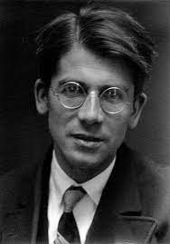
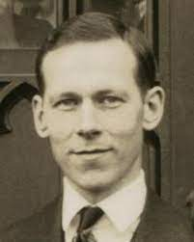
FUNDAMENTALS OF APPLIED CHEMISTRY
MOLECULAR ORBITAL THEORY
F. Hund
R. S. Mulliken

Slide 2
Learning Outcomes
Introduction to MOT
LCAO-Linear combination of atomic orbitals
Conditions for effective overlap of atomic orbitals
BMO and ABMO
How to build MO and their significance- Homonuclear and Heteronuclear
Use of MOT in predicting the physical/chemical properties of materials

Slide 3


MOT, Why?
Introduction to MOT
Existence of a molecule orbitals and stability of the molecule
Bond order
Directional nature of bonds
Para/diamagnetic nature of molecule
Whether compound is coloured or not
Because VBT does not explain..…
It was proposed to discuss the structure and properties of different molecules.
Atomic orbitals combine to form molecular orbitals.

Slide 4

Fundamentals of MOT
A molecule is viewed on a quantum mechanical level as a collection of nuclei surrounded by delocalized molecular orbitals.
Atomic wave functions are summed to obtain molecular wave functions.
If wave functions reinforce each other, a bonding MO is formed (region of high electron density exists between the nuclei).
If wave functions cancel each other, an antibonding MO is formed (a node of zero electron density occurs between the nuclei).

Slide 5
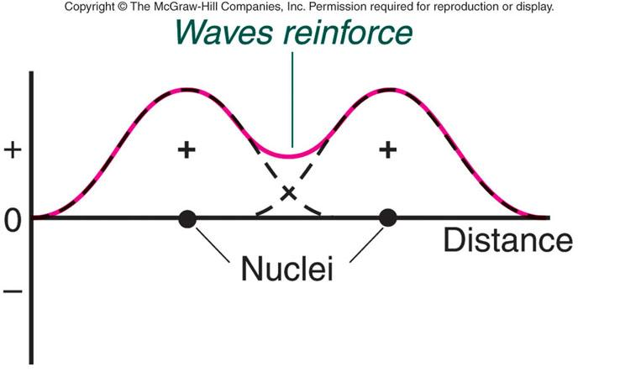
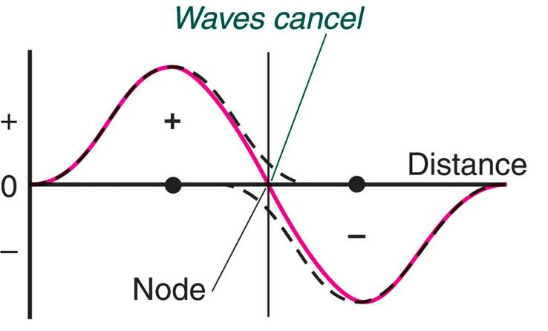
Waves are in phase
𝜙 = 𝜓_{A}+ 𝜓_{B}
Where 𝜓_{A} and 𝜓_{B} are amplitudes of electron waves of the AOs of two atoms A and B
BMO
Amplitudes of wave functions are added
Waves are out of phase
𝜙 = 𝜓_{A}-𝜓_{B}
Where 𝜓_{A} and 𝜓_{B} are amplitudes of electron waves of the AOs of two atoms A and B
ABMO
Amplitudes of wave functions are subtracted

Slide 6
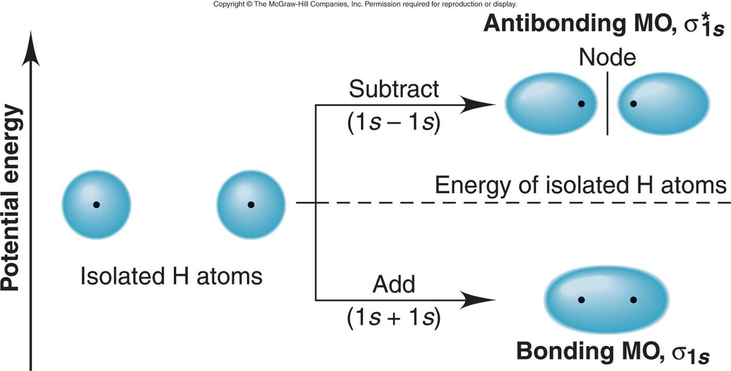
MOT for H₂ molecule
Points to remember:
BMOs are lower in energy than that of isolated AOs whereas ABMOs are higher in energy than that of AOs.
AOs must have similar energy and orientation to form MOs.
BMOs are σ, π and ABMOs are σ*, π*
Contours and energies of the bonding and antibonding molecular orbitals in H₂

Slide 7
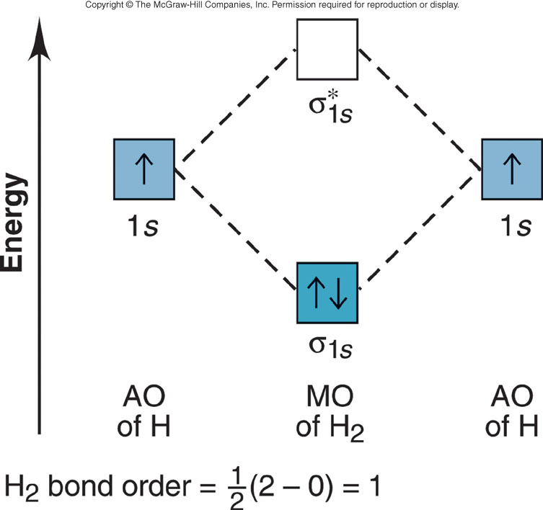
MO diagram for the H₂ molecule
Points to remember:
MOs are combination of AOs
No. of MOs formed= No. of AOs combined
MOs are filled in the same sequence as for AOs. It means MOs also follow:
a) Aufbau principle
b) Pauli’s exclusion principle
c) Hund’s rule

Slide 8

The MO bond order Calculation
[1/2 (no. of e⁻ in bonding MOs) - (no. of e⁻ in antibonding MOs)]
Higher the bond order, stronger the bond
If Bond order is 0, It means molecule can’t exist
For example,

Slide 9
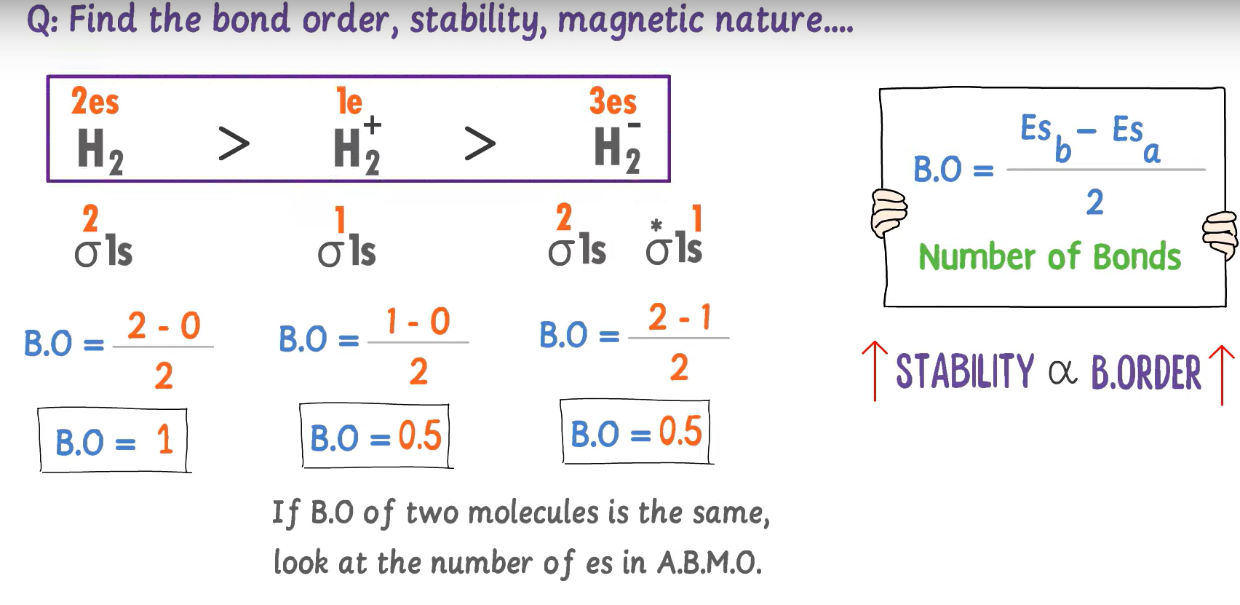

Slide 10
MO diagram for the He₂⁺ and He₂ molecule
σ*_{1s}
σ*_{1s}
1s
1s
1s
1s
Energy
Energy
AO of He
AO of He⁺
AO of He
AO of He
σ_{1s}
σ_{1s}
MOs of He₂⁺
MOs of He₂
He₂⁺ bond order = 1/2
He₂ bond order = 0
can exist!
cannot exist!

Slide 11
Predicting species stability using MO diagrams
PROBLEM:
Use MO diagrams to predict whether H₂⁺ and H₂⁻ can exist. Determine their bond orders and electron configurations.
PLAN:
Use H₂ as a model and accommodate the number of electrons in bonding and antibonding orbitals. Calculate the bond order.
SOLUTION:
Bond order = 1/2(1-0) = 1/2
Bond order = 1/2(2-1) = 1/2
σ*
H₂⁺ does exist!
σ*
H₂⁻ does exist!
1s
1s
1s
1s
AO of H
AO of H⁻
AO of H
AO of H⁺
σ
σ
MO of H₂⁺
MO of H₂⁻
configuration is (σ_{1s})¹
configuration is (σ_{1s})²(σ*_{1s})¹

Slide 12
MO diagram for the Li₂ and Be₂ molecule
σ*_{2s}
σ*_{2s}
2s
2s
2s
2s
Energy
Li₂
Be₂
Bond order = 1
σ_{2s}
σ_{2s}
bond order = 0
σ*_{1s}
σ*_{1s}
1s
1s
1s
1s
Bonding in s-block homonuclear diatomic molecules
σ_{1s}
σ_{1s}

Slide 13

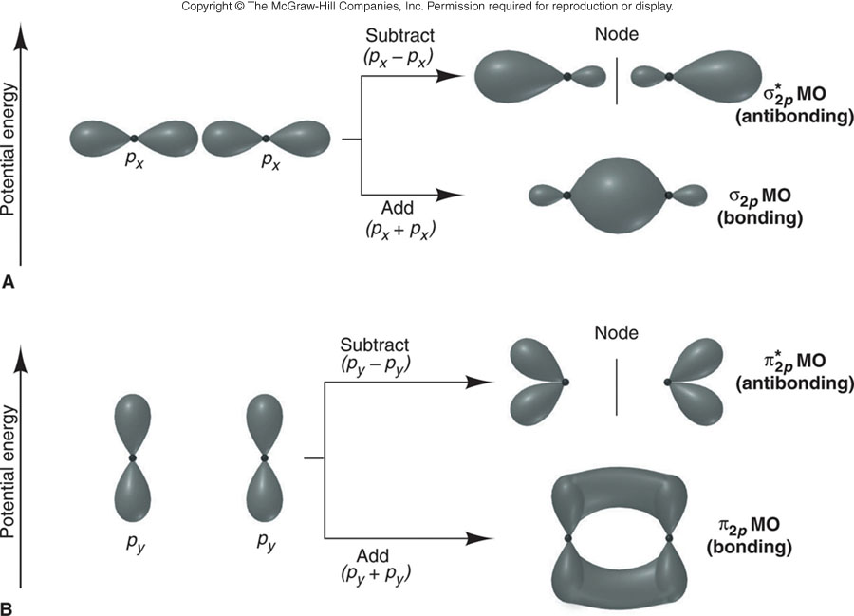
Contours and energies of σ and π MOs through combinations of 2p AOs
Points to remember:
BMOs and ABMOs for core electrons cancel, they don’t contribute to bonding
Only MO diagrams showing MOs created by combining valence electron molecular orbitals are important.
end-to-end overlap
side-to-side overlap

Slide 14
Order of Relative energies
σ_{2p} < π_{2p} < π*_{2p} < σ*_{2p}
More effective end-to-end interaction relative to side-to-side in bonding MOs

Slide 15
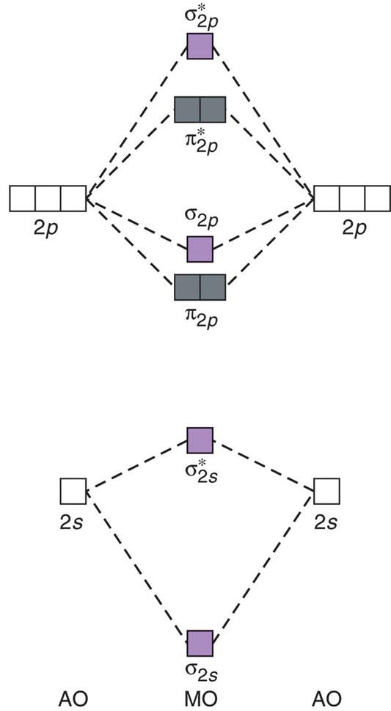
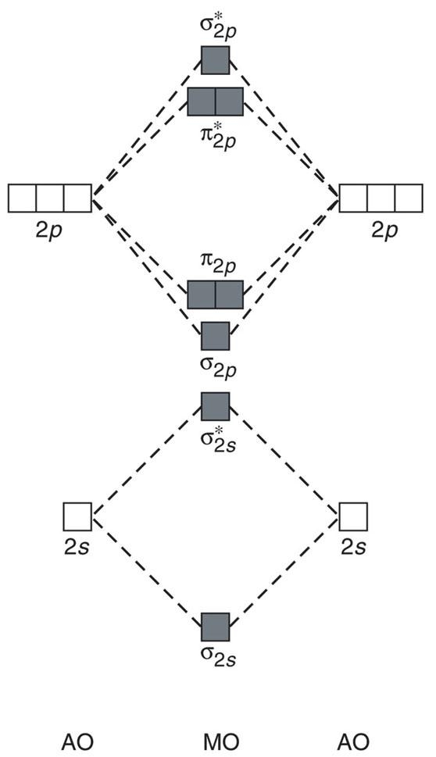
Relative MO energy levels for Period 2 homonuclear diatomic molecules
without 2s-2p mixing
with 2s-2p mixing
MO energy levels for O₂, F₂ and Ne₂
MO energy levels for B₂, C₂ and N₂

Slide 16
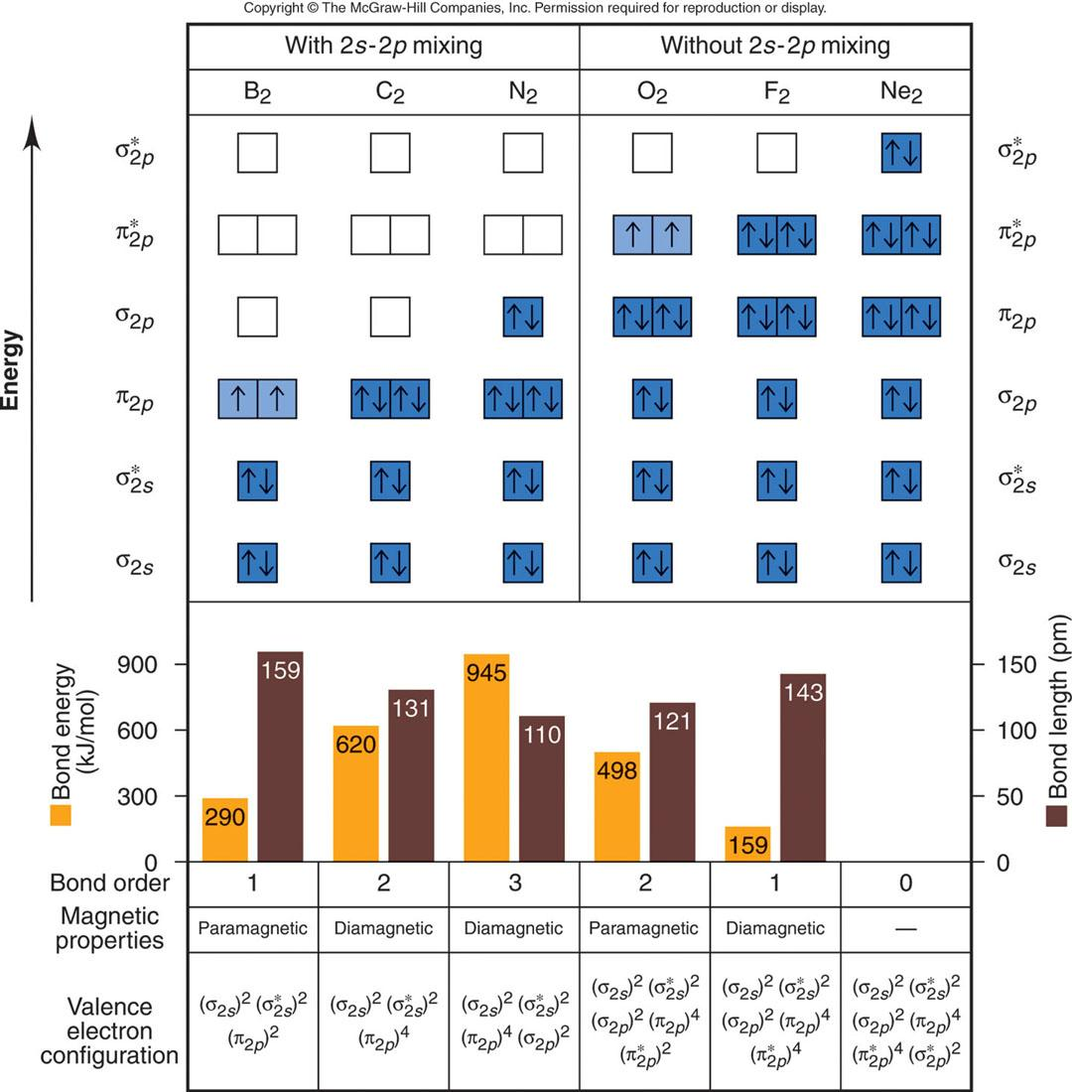
MO occupancy and molecular properties for B₂ through Ne₂

Slide 17
Using MO theory to explain bond properties
PROBLEM:
As the following data shows, removing an electron from N₂ forms an ion with a weaker, longer bond than in the parent molecule, whereas the ion formed from O₂ has a stronger, shorter bond.
N₂
N₂⁺
O₂
O₂⁺
Bond energy (kJ/mol)
945
841
498
623
Bond length (pm)
110
112
121
112
Explain these facts with diagrams showing the sequence and occupancy of MOs.
PLAN:
Find the number of valence electrons for each species, draw the MO diagrams, calculate bond orders, and compare the results.
SOLUTION:
N₂ has 10 valence electrons, so N₂⁺ has 9.
O₂ has 12 valence electrons, so O₂⁺ has 11.

Slide 18
(continued…)
N₂
N₂⁺
O₂
O₂⁺
σ*_{2p}
σ*_{2p}
antibonding e⁻ lost
π*_{2p}
bonding e⁻ lost
π*_{2p}
σ_{2p}
π_{2p}
π_{2p}
σ_{2p}
σ*_{2s}
σ*_{2s}
σ_{2s}
σ_{2s}
1/2(8-2) = 3
1/2(7-2) = 2.5
1/2(8-4) = 2
1/2(8-3) = 2.5
(weaker)
Bond orders
(weaker)

Slide 19
Heteronuclear Diatomic Molecules
The MO diagram for HF
σ*
Point to remember:
In polar covalent compounds, bonding MOs are closer in energy to the AOs of the more electro-negative atom.
Energy
1s
NBMOs
2p_{x}
2p_{y}
2p
lower in energy
than 1s of H!
σ
AO of H
MO of HF
AO of F

Slide 20
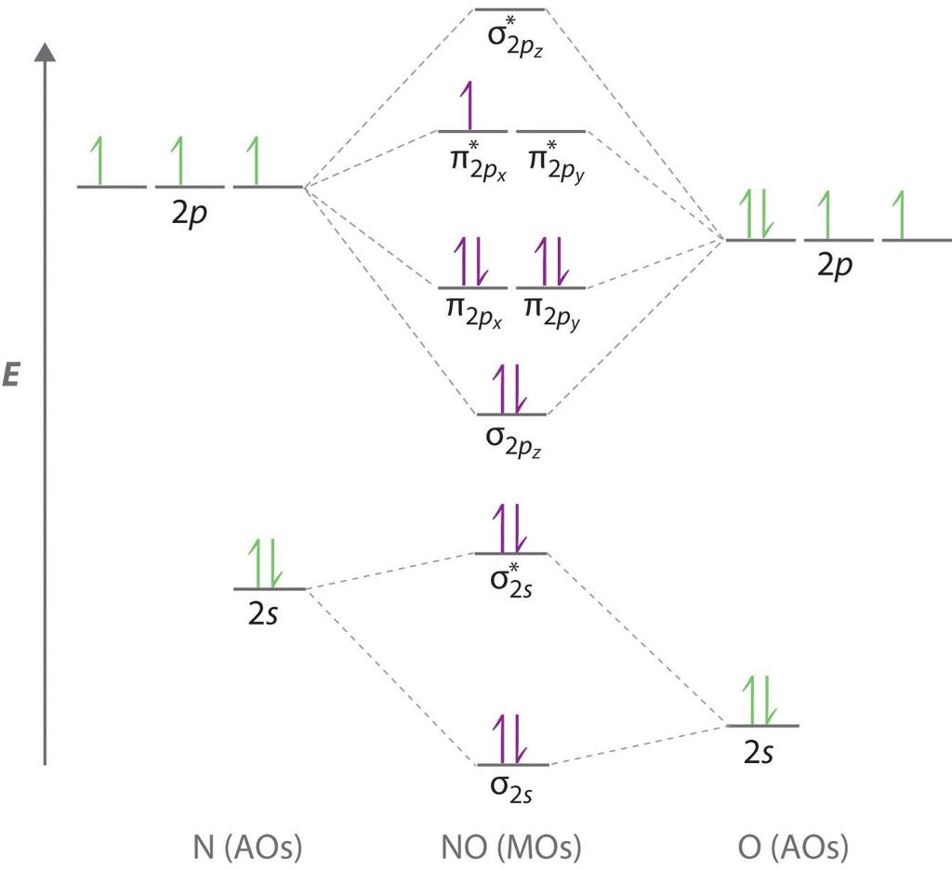
The MO diagram for NO

Slide 21
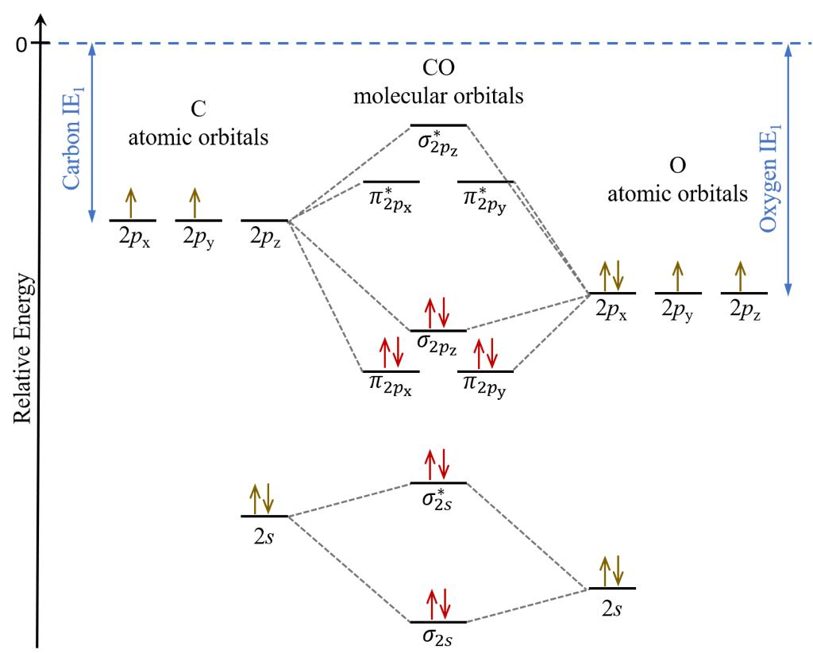
The MO diagram for CO

Slide 22
THANK YOU

